Slide 1
Chapter 2: Bits and Bytes II
Bit-Level Operations in C
&, |, ~, ^
Bit Masking
Logical Expressions
Logical Operations in C
&&, ||, and !
Bit Shifting
<< Left Shift
>> Right Shift (Logical and Arithmetic)
Integer Representations
Unsigned and Two’s Complement
Integer Arithmetic and overflow

Slide 2
Announcements
Chap 2 Data Quiz is due Monday Jan 30 by noon
Addition, subtraction, signed, overflow
Data Lab is due Friday Feb 3 by 11:55 pm
Bit manipulation operations
C assessment quiz – extended deadline
Unlimited # of attempts until May 5
May be getting a new TA
May be opening up a new recitation
Read Chapter 2.1-2.3 and do practice problems

Slide 3
Recap…
Computer Architecture
Binary representations – base 2
Binary digital logic – AND, OR, ~, etc.
Hexadecimal representations – base 16
Byte-addressed memory
Representing data in C
ints, longs, shorts, floats, doubles, chars, etc.
Pointers in C
Bit vector logic

Slide 4
Bit-Level Operations in C
Operations &, |, ~, ^ Available in C
Apply to any “integral” data type
long, int, short, char
View arguments as bit vectors
Arguments applied bit-wise
Examples (Char data type)
~0x41 --> 0xBE
~01000001₂ --> 10111110₂
~0x00 --> 0xFF
~00000000₂ --> 11111111₂
0x69 & 0x55 --> 0x41
01101001₂ & 01010101₂ --> 01000001₂
0x69 | 0x55 --> 0x7D
01101001₂ | 01010101₂ --> 01111101₂

Slide 5
Bit Masking
Example: Mask out the 4 least significant bits of a byte 0x69
Let mask = 0xF0
0x69 & 0xF0 --> 0x60
01101001₂ & 11110000₂ --> 01100000₂
Example: Mask out all but the most significant bit of a byte 0x69
Let mask = 0x80
0x69 & 0x80 --> 0x00
01101001₂ & 10000000₂ --> 00000000₂

Slide 6
Logical vs Bitwise Operations in C
Logical Operators
&& (AND), || (OR), ! (NOT or “bang”)
View 0 as “False”
Anything nonzero as “True”
Always return 0 or 1
Early termination
Example code:
int x,y,z;
….
if ( !((x==0) && (x>y)) || (z<256) ) {
…
z = ~(x & y) | z;
}
Each logical expression is
either TRUE (1) or FALSE (0):
(x==0)
(x>y)
((x==0) && (x>y))
!((x==0) && (x>y))
(z<256)
!((x==0) && (x>y)) || (z<256)
Compare to the bit-wise
logical operations, where input, intermediate, and final values don’t have to be 0 or 1
By the way, parentheses
are your friend, and good
programming practice
Notes:
Note the input to a logical expression can contain any non-zero expression. In the example above, all the sub-expressions are either TRUE (1) or FALSE (0). Another possibility is the following: if (x) { … do_something() …}, of if (!y) { … do_something() …}. Here the inputs x and y are not restricted to 1 and 0. See next slide for how logical expressions handle such input values.

Slide 7
Logical vs Bitwise Operations in C (2)
Logical
!0x41 --> 0x00
!0x00 --> 0x01
!!0x41 --> 0x01
0x69 && 0x55 --> 0x01
0x69 || 0x55 --> 0x01
Bitwise
~0x41 --> 0xBE
~01000001₂ --> 10111110₂
~0x00 --> 0xFF
~00000000₂ --> 11111111₂
0x69 & 0x55 --> 0x41
01101001₂ & 01010101₂ --> 01000001₂
0x69 | 0x55 --> 0x7D
01101001₂ | 01010101₂ --> 01111101₂
p && *p (avoids null pointer access)
*p by itself could result in dereferencing a null pointer, causing an error, e.g. the line ‘if (*p)’ will cause an error if p has not been set yet
So use ‘if (p && *p)’, which first tests ‘if p’, and only if true (p is not null) will it proceed to the rest of the if test, i.e. try to dereference the pointer *p
Notes:
A pointer typically initializes to NULL (though it is safer to initialize it rather than assuming this), so technically it is pointing to memory address zero. Dereferencing a null pointer means your application is trying to access memory location zero. Usually, code is stored at lower memory addresses starting from zero. At memory location 0, the code is typically special code used by the OS to load an application into memory and set it up for execution, so it is an error for an application pointer to try to reference it, presumably to modify its value.

Slide 8
Logical vs Bitwise Operations in C (3)
Example code:
int x,y;
…
if (x) { … do1(); …}
if (!y) { … do2(); …}
This is shorthand for ‘if (x!=0) {…}’,
So do1() is called only if x is non-zero,
i.e. if x==1, then do1() is called,
if x==137, do(1) is called, …
if x==0, then do(1) is not called.
do2() is called only if y is zero, i.e.
This is equivalent to ‘if (y==0) {…}’
i.e. if y==0, then do2() is called,
if y==1, then do2() is not called,
if y==137, then do2() is not called…

Slide 9
Bit Shifting Operations
Example #1: x << 1,
left-shift by 1 bit
Useful for multiplication and division by powers of 2
X = 0110 = 6
X<<1 = 1100 = 12 = 2*6!
insert 0 00111100
X
Left Shift: x << y
Shift bit-vector x left y positions
Throw away extra bits on left
Fill with 0’s on right
So x << 1 =
Multiplication by two!
Right Shift: x >> y
Shift bit-vector x right y positions
Throw away extra bits on right
Logical shift
Fill with 0’s on left
Arithmetic shift
Replicate most significant bit on left
Useful with two’s complement integer representation
Example #2: y >> 1,
right-shift by 1 bit
Y = 1100 = 12
Y>>1 = 0110 = 6 = 12/2!
insert 0 (logical shift)
So y >> 1 =
Division by two!
Notes:
“x << y” means x*(2^y), that is x multiplied by (2 to the power y)
“x >> y” mean x/(2^y), that is x divided by (2 to the power y)

Slide 10
Shift Operations
Useful for multiplication and division by powers of 2
Left Shift: x << y
Shift bit-vector x left y positions
Throw away extra bits on left
Fill with 0’s on right
Argument x
01100010
<< 3
00010000
00010000
00010000
Log. >> 2
00011000
00011000
00011000
Arith. >> 2
00011000
00011000
00011000
Right Shift: x >> y
Shift bit-vector x right y positions
Throw away extra bits on right
Logical shift
Fill with 0’s on left
Arithmetic shift
Replicate most significant bit on left
Useful with two’s complement integer representation
Argument x
00010000
10100010
<< 3
00010000
00010000
00010000
Log. >> 2
00101000
00101000
00101000
Arith. >> 2
11101000
11101000
11101000

Slide 11
Shift Operations in C
If your word x is signed, then it is not defined in C whether x >> y will do an arithmetic or logical right shift on x
However, most implementations assume that a right shift on a signed quantity is an arithmetic right shift.
Example: If x is declared as an int, then ints are signed by default, so x >> y should do an arithmetic right shift on x by y bits
If your word is unsigned, then x>>y will do a logical right shift on x
Example: If x is declared as an unsigned int, then x >> y will do a logical right shift on x by y bits.
Notes:
See textbook. Also, in Java, all ints are signed, and x >> k means arithmetic right shift while x >>> k means logical right shift.

Slide 12
Encoding Integers
Unsigned 4-bit Integers
Decimal
1 | 1 | 1 | 1
1 | 1 | 1 | 0
1 | 1 | 0 | 1
1 | 1 | 0 | 0
1 | 0 | 1 | 1
1 | 0 | 1 | 0
1 | 0 | 0 | 1
1 | 0 | 0 | 0
0 | 1 | 1 | 1
0 | 1 | 1 | 0
0 | 1 | 0 | 1
0 | 1 | 0 | 0
0 | 0 | 1 | 1
0 | 0 | 1 | 0
0 | 0 | 0 | 1
0 | 0 | 0 | 0
15
14
13
12
11
10
9
8
7
6
5
4
3
2
1
0
Signed and unsigned integers
Let’s start with unsigned integers, assuming only 4 bits (16 values):
3
Decimal = Σ b_{i} * 2^{i}
i=0
bit in word
corresponding
to i’th power
of 2
For a w-bit word,
Decimal = Σ b_{i} * 2^{i}
w-1
i=0
Book uses B2U for “Binary To Unsigned integer”
2³ 2² 2¹ 2⁰

Slide 13
Representing Negative Integers?
Simplest approach is to use the most significant bit as the sign bit: ‘1’ = negative, ‘0’ = positive
e.g. 0100 = +4, while 1100 = -4
This is called Sign-Magnitude
Unfortunately, this means we have both
a Positive Zero (0000 = +0) and
a Negative Zero (1000 = -0) !!!
This complicates integer arithmetic
Notes:
One’s complement has a nice property that if you flip the bits, you get the negative version of a number, which then results in the function B2O shown. One’s complement has the same weakness as Sign-Magnitude, namely there are two representations for zero: 0000 and 1111.

Slide 14
Two’s Complement
Signed 4-bit Integers
Decimal
0 | 1 | 1 | 1
0 | 1 | 1 | 0
0 | 1 | 0 | 1
0 | 1 | 0 | 0
0 | 0 | 1 | 1
0 | 0 | 1 | 0
0 | 0 | 0 | 1
0 | 0 | 0 | 0
1 | 1 | 1 | 1
1 | 1 | 1 | 0
1 | 1 | 0 | 1
1 | 1 | 0 | 0
1 | 0 | 1 | 1
1 | 0 | 1 | 0
1 | 0 | 0 | 1
1 | 0 | 0 | 0
7
6
5
4
3
2
1
0
-1
-2
-3
-4
-5
-6
-7
-8
Two’s complement encodes signed integers (positive and negative)
Easy to implement integer arithmetic with two’s complement – unique zero
Most significant (MS) bit is sign bit with weight –(2^{w-1}), i.e. -8 when w=4 bits
Example: ‘1101’
= 1*(-2³) + 1*2² + 0*2¹ + 1*2⁰ = -3
‘1000’ = -8, ‘1111’ = -1 (not 15), zero is unique & zero
-(2³) 2² 2¹ 2⁰
Notes:
Two’s complement is also very easy to implement in digital logic circuits. Two’s complement addition and unsigned addition have identical bit-level behavior.

Slide 15
Two’s Complement
Signed 4-bit Integers
Decimal
0 | 1 | 1 | 1
0 | 1 | 1 | 0
0 | 1 | 0 | 1
0 | 1 | 0 | 0
0 | 0 | 1 | 1
0 | 0 | 1 | 0
0 | 0 | 0 | 1
0 | 0 | 0 | 0
1 | 1 | 1 | 1
1 | 1 | 1 | 0
1 | 1 | 0 | 1
1 | 1 | 0 | 0
1 | 0 | 1 | 1
1 | 0 | 1 | 0
1 | 0 | 0 | 1
1 | 0 | 0 | 0
7
6
5
4
3
2
1
0
-1
-2
-3
-4
-5
-6
-7
-8
Asymmetric range from -8 to +7
one more negative # than positive # !
MS bit indicates sign
1=>negative, 0=>non-negative
For a w-bit word,
Decimal = -b_{w-1} * 2^{w-1}
+ Σ b_{i} * 2^{i}
Book uses B2T for “Binary To Two’s Complement Integer”
// MS sign
Bit
w-2
// LS Bits
i=0
-(2³) 2² 2¹ 2⁰
Notes:
LS = Least Significant

Slide 16
Encoding Integers
Unsigned
Two’s Complement
short int x = 15213;
short int y = -15213;
Most Significant
Bit is in essence
the Sign Bit
C short 2 bytes long
For 2’s complement, most significant bit indicates sign
0 for nonnegative
1 for negative
Shortcut to get –x given x: complement x and add 1
i.e. -x = ~x + 1 in two’s complement

Slide 17
Encoding Example (Cont.)
x = 15213: 00111011 01101101
y = -15213: 11000100 10010011

Slide 18
Numeric Ranges
Unsigned Values
UMin = 0
000…0
UMax = 2^{w} – 1
111…1
Two’s Complement Values
TMin = –2^{w–1}
100…0
TMax = 2^{w–1} – 1
011…1
Other Values
Minus 1
111…1
Values for W = 16
unsigned
two’s
complement
both

Slide 19
Values for Different Word Sizes
Observations
|TMin | = TMax + 1
Asymmetric range
UMax = 2 * TMax + 1
C Programming
#include <limits.h>
K&R App. B11
Declares constants, e.g.,
ULONG_MAX
LONG_MAX
LONG_MIN
Values platform-specific

Slide 20
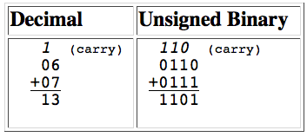
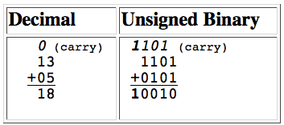
Unsigned Integer Addition
Example: 4-bit addition of 6 + 7
Just as for decimal, there is a carry, e.g. 1 added to 1 causes a carry of a 1 to the next column
Example: 13 + 5
Note that the last carry = 1 which shows that there is an overflow
= 2!
(ignoring carry)
How to detect overflow?
See if the MS/final carry bit = 1

Slide 21
Unsigned Modular Addition
u
• • •
Operands: w bits
+
v
• • •
True Sum: w+1 bits
u + v
• • •
Discard Carry: w bits
UAdd_{w}(u , v)
• • •
Standard Addition Function
Ignores carry output
Implements Modular Arithmetic
s = UAdd_{w}(u , v) = (u + v) mod 2^{w}
Notes:
You should avoid subtracting two unsigned integers. If unsigned x < unsigned y, then “x-y” could result in a “negative” number. In C, the arithmetic is modulo N-bit (e.g. N=32 or 64), so the results of “unsigned x – unsigned y” where x < y would be a “negative” value modulo say 2^64, resulting in a very large positive #.

Slide 22
Visualizing Ideal Integer Addition
Integer Addition
4-bit integers u, v
Compute true sum Add₄(u , v)
Values increase linearly with u and v
Forms planar surface
With 4-bit integers, the true sum could require 5 bits
Add₄(u , v)
v
u

Slide 23
Visualizing Unsigned Modular Addition
Wraps Around
If true sum ≥ 2^{w}
At most once
Overflow
UAdd₄(u , v)
True Sum
2^{w+1}
Overflow
2^{w}
v
0
Modular Sum
u
Example: ‘1111’ + ‘0001’ = ‘0000’!

Slide 24
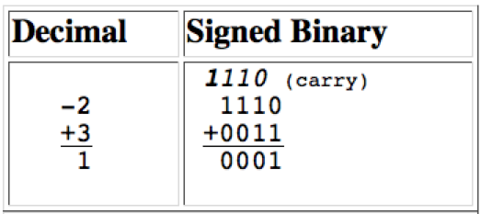
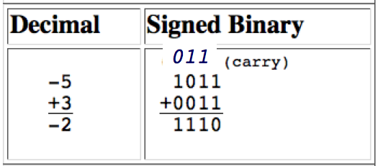
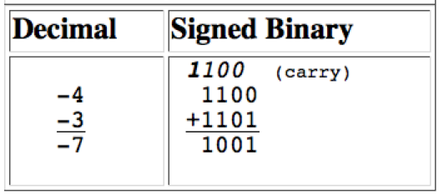
Two’s Complement Addition
Similar to unsigned addition with the carry rules
1 added to 1 causes a carry of a 1 to the next column
Note, here the final carry does not necessarily indicate overflow
In all examples, just the 4-bit result is correct, regardless of the carry
In Two’s complement, subtraction is same operation as addition!
Notes:
i.e. in two’s complement, 7-2 = 7 + (-2) !

Slide 25
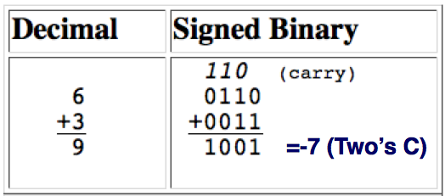
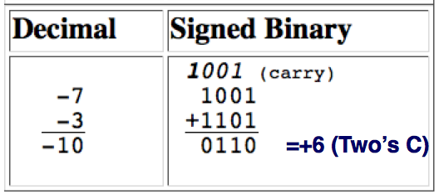
Two’s Complement Overflow
Example: 6 + 3
Overflows the maximum positive value for 4-bit two’s complement (+7)
Example: -7 – 3
Overflows the maximum negative value for 4-bit two’s complement (-8)
How to detect overflow?
If the sign of the operands are the same and the sum is the opposite sign, then there is overflow in two’s complement signed addition
In both examples, both operands are + or -, but the sum is the opposite sign
Notes:
Note how in the first example, even though there is overflow in two’s complement, there is no carry bit set, so we cannot simply apply the rule as we did for unsigned addition that overflow occurs if and only if the carry bit is set.

Slide 26
Two’s Complement Modular Addition
u
• • •
Operands: w bits
+
v
• • •
True Sum: w+1 bits
u + v
• • •
Discard Carry: w bits
TAdd_{w}(u , v)
• • •
TAdd and UAdd have Identical Bit-Level Behavior
Signed vs. unsigned addition in C:
int s, t, u, v;
s = (int) ((unsigned) u + (unsigned) v);
t = u + v
Will give s == t
Unsigned add UAdd
Signed add TAdd
Notes:
The type “int” is by default signed.

Slide 27
Visualizing Two’s Complement Signed Addition
NegOver
Values
4-bit two’s comp.
Range from -8 to +7
Wraps Around
If sum ≥ 2^{w–1}
Becomes negative
At most once
If sum < –2^{w–1}
Becomes positive
At most once
TAdd₄(u , v)
v
PosOver
u

Slide 28
Characterizing TAdd
Functionality
True sum requires w+1 bits
Drop off carry bit
Treat remaining bits as 2’s comp. integer
True Sum
0 111…1
2^{w}–1
PosOver
TAdd Result
0 100…0
2^{w –1}
011…1
0 000…0
0
000…0
PosOver
1 100…0
–2^{w –1}
100…0
TAdd(u , v)
1 000…0
–2^{w}
NegOver
> 0
v
< 0
(NegOver)
< 0
> 0
u
(PosOver)
NegOver
Lesson: as sum reaches large #’s (>billion for 32-bit ints), get strange results

Slide 29
Detecting 2’s Comp. Overflow
Task
Given s = TAdd_{w}(u , v)
Determine if s = Add_{w}(u , v)
Example
int s, u, v;
s = u + v;
Claim
Overflow iff either:
u, v < 0, s ≥ 0 (NegOver)
u, v ≥ 0, s < 0 (PosOver)
ovf = (u<0 == v<0) && (u<0 != s<0);
2^{w}–1
PosOver
2^{w –1}
0
NegOver

Slide 30
Summarizing…
NegOver
TAdd₄(u , v)
Two’s complement Overflow
Two large positive #’s can sum to a negative # (PosOver)
Then, sum of u and v = TrueSum(u + v) - 2^{w}, given w bits
Two large negative #’s can sum to a positive # (NegOver)
Then, sum of u and v = TrueSum(u + v) + 2^{w}, given w bits
v
PosOver
u

Slide 31
Supplementary Slides

Slide 32
One’s Complement
For a w-bit word,
Decimal = -b_{w-1} * (2^{w-1} -1) + Σ b_{i} * 2^{i}
Also called B2O for “Binary To One’s Complement Integer”
w-2
i=0
One’s complement has a nice property that if you flip the bits, you get the negative version of a number, which then results in the function B2O above.
One’s complement has the same weakness as Sign-Magnitude, namely there are two representations for zero: 0000 and 1111.

Slide 33
C Puzzles - practice
Taken from old exams
Assume machine with 32 bit word size, two’s complement integers
For each of the following C expressions, either:
Argue that is true for all argument values
Give example where not true
x < 0 ⇒ ((x*2) < 0)
ux >= 0
x & 7 == 7 ⇒ (x<<30) < 0
ux > -1
x > y ⇒ -x < -y
x * x >= 0
x > 0 && y > 0 ⇒ x + y > 0
x >= 0 ⇒ -x <= 0
x <= 0 ⇒ -x >= 0
Initialization
int x = foo();
int y = bar();
unsigned ux = x;
unsigned uy = y;

Slide 34
C Puzzle Answers
Assume machine with 32 bit word size, two’s comp. integers
TMin makes a good counterexample in many cases
x < 0 ⇒ ((x*2) < 0) False: TMin
ux >= 0 True: 0 = UMin
x & 7 == 7 ⇒ (x<<30) < 0 True: x₁ = 1
ux > -1 False: 0
x > y ⇒ -x < -y False: -1, TMin
x * x >= 0 False: 30426
x > 0 && y > 0 ⇒ x + y > 0 False: TMax, TMax
x >= 0 ⇒ -x <= 0 True: –TMax < 0
x <= 0 ⇒ -x >= 0 False: TMin
x < 0 ⇒ ((x*2) < 0)
ux >= 0
x & 7 == 7 ⇒ (x<<30) < 0
ux > -1
x > y ⇒ -x < -y
x * x >= 0
x > 0 && y > 0 ⇒ x + y > 0
x >= 0 ⇒ -x <= 0
x <= 0 ⇒ -x >= 0

Slide 35
Two’s Complement Shortcuts: Negation
Claim: Following Holds for 2’s Complement
~x + 1 == -x
Complement
Observation: ~x + x == 1111…11₂ == -1
Increment
~x + x + (-x + 1) == -1 + (-x + 1)
~x + 1 == -x
Warning: Be cautious treating int’s as integers
OK here
x
1
0
0
1
1
1
0
1
+
~x
0
1
1
0
0
0
1
0
-1
1
1
1
1
1
1
1
1

Slide 36
Negation == Complement then Increment
x = 15213
0

Slide 37
Two’s Complement Shortcuts: Negation (2)
Another way to calculate –x from x in Two’s Complement:
Write decimal x in binary.
start at the LS bit of x, copying all zeros to y until first 1 is reached; copy that 1, and then flip all the remaining bits and copy them to y. Then y=-x.
For example: 60 = 00111100₂. To calculate -60, copy all zeros to the right of the first 1, so y = 100₂. Then, flip all other bits and copy to y, so y = 11000100₂ = -128 + 64 + 4 = -60.

